Slide 1
DEVELOP AN OUTCOME L2
Evidence of Learning Template
YOUR NSN NUMBER HERE: 0160748887
Project Title
YOUR NAME HERE: Anh Nguyen

Slide 2
Github /Drive link
Trello board or PM link
https://trello.com/invite/b/aLYMcwrX/be7e146ac5ae657033cadeb5ac3fe3f8/planning
You MUST provide evidence showing how the problem has been decomposed, how the components have been developed and trialled, and of how they have been assembled and tested to create a final, working outcome.

Slide 3
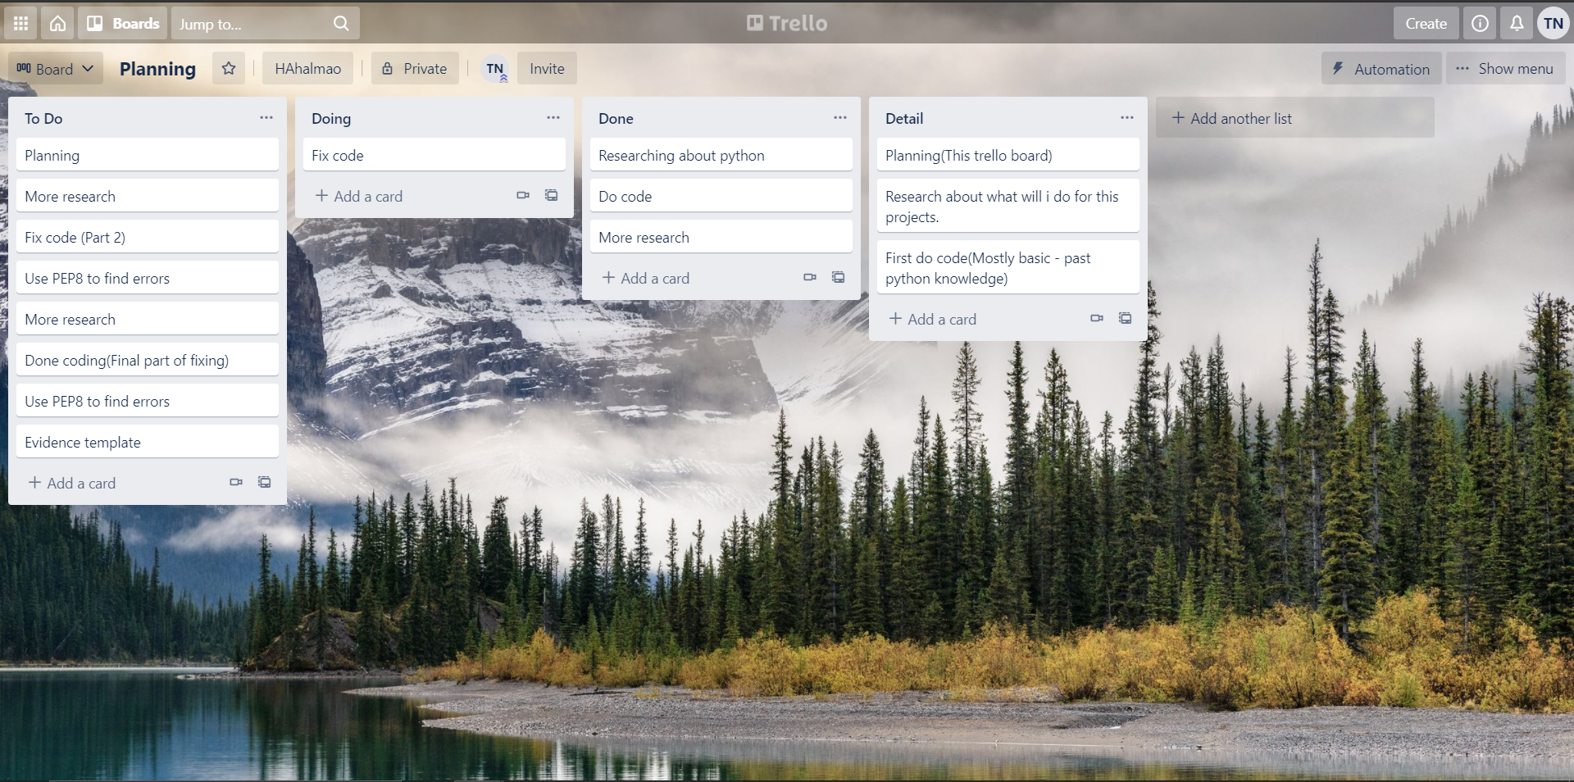
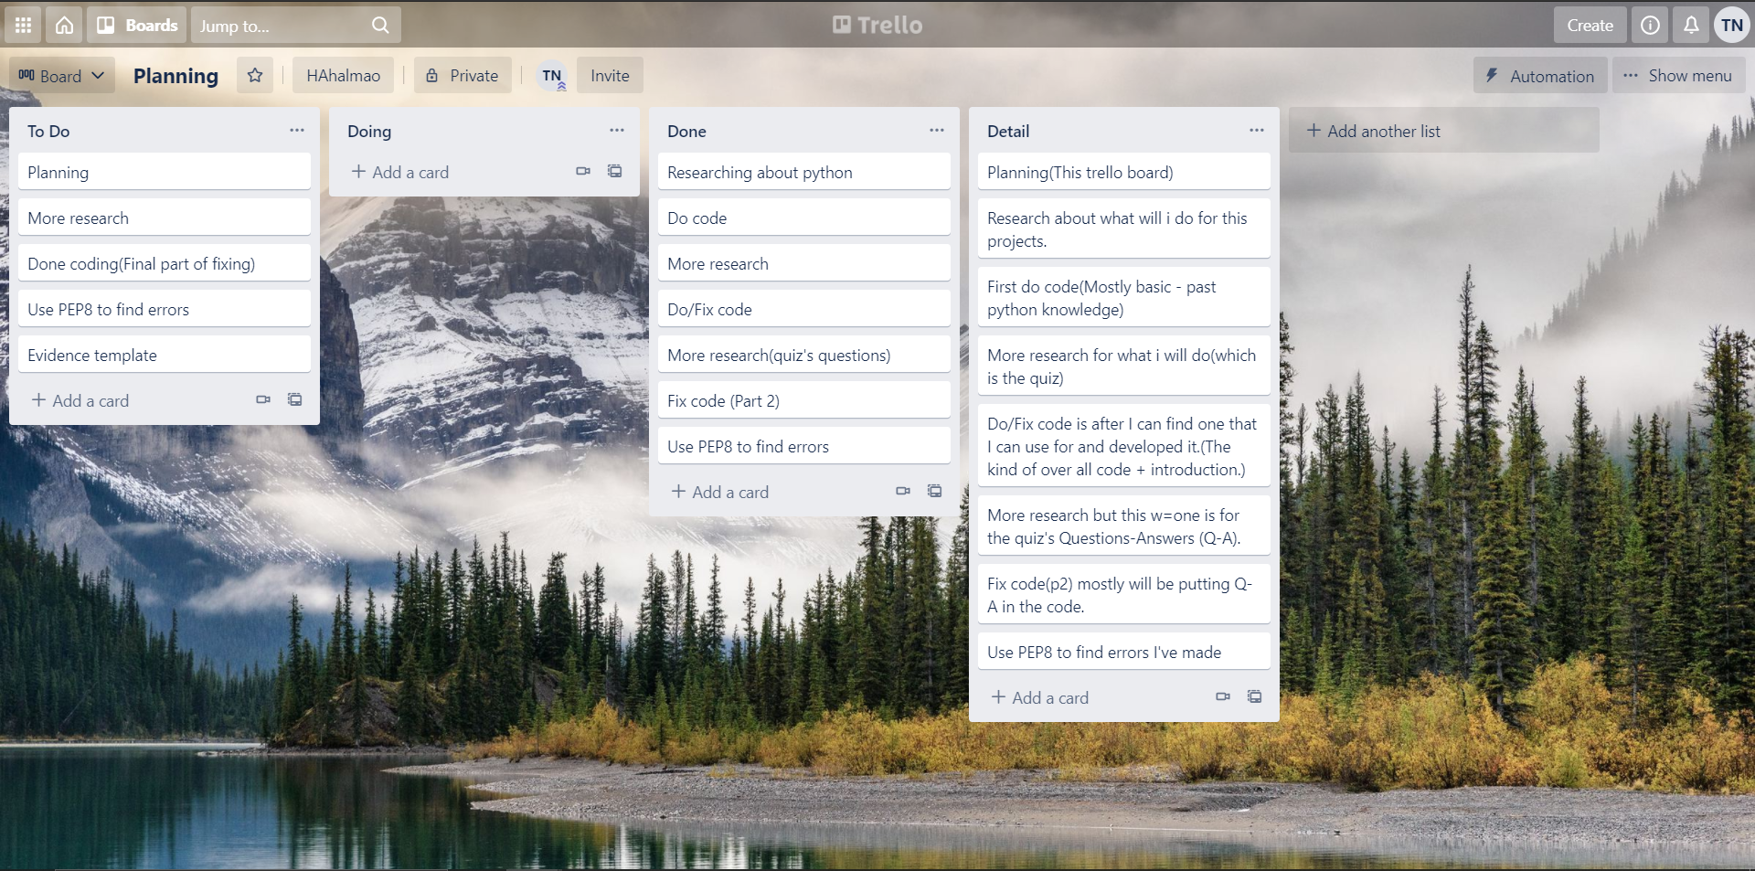
Project management: Setup
60% through the coding(nothing in the DOing part because i was resting at the moment.)
First few weeks of coding.

Slide 4
Project management: Setup
I chose Trello for my personal project management. I chose it over other projects management tools like because I could be better at time management along with my project. And since Trello board is better for an individual rather than a team (it can still be used for a team), I chose it over Monday.com (more of a team projects) or Google calendar (I’m not really used to this one). I can easily understand how to do it in an instant. And I especially like the drag and drop from Trello board. You can just drag and drop it from this column to the other for easier project management.
This is the link for the completed trello board management for my projects: Trello board

Slide 5
Decomposing outcome
Record evidence that you have broken the outcome into smaller components.
This is the doc to my decomposing.
Decomposing

Slide 6
Trialling components
Record evidence that you have trialled components. Show that you gathered information to inform your decision making.
This is the link to my trialling errors
Trialling errors

Slide 7
Testing outcome
Explain how the testing made sure your outcome functions as intended to meet its purpose and requirements.
This is the link to my testing outcome
Testing outcome

Slide 8
Project management: Applied
Record evidence that you have used your project management tools to manage the development of your outcome.
I first use Bracket, then Pycharm but finally i choose Replit to do the coding. I try a couple of different project management like Monday.com, Google doc/calendar but i prefer Trello board.
Record evidence that you have used your project management techniques to manage the development of your outcome.
Link to my Trello board: Trello Board

Slide 9
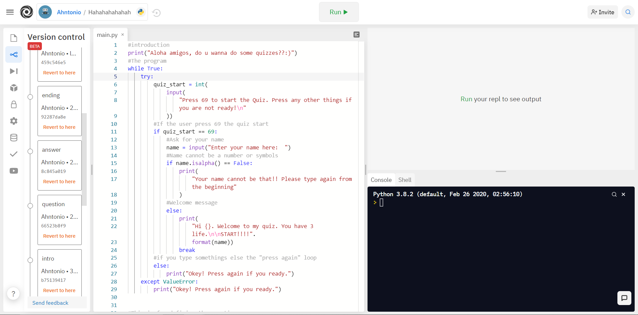
Version Control
Your version control evidence should go here. This could be in the form of annotated screenshots which show you you managed this process or you could make a brief screencast explaining how you implemented version control.
(Replit has innate version control.) (I took this every time I make a change of my code.)

Slide 10
Relevant Implications
Record evidence that you have addressed the Implications that are relevant to your outcome.
Ethical - This is not a bad game of quiz and it’s for everyone because it does not inappropriate any bad content and it won’t cause harm on anybody.
Accessibility - I would say this quiz can be access using any device that has Google Chrome/ Safari or any similar apps. There is basically no control needed for this game. All you need is a working keyboard on your laptop/PC or a working screen on your phone.
End users - I try to make it a tricky/riddle quiz so that they must think about many different situations.
Font/spacing of the text- The program must work and easy to navigate so I included “text instructions” before each step. Seperation lines will be printed at the end of each question to make them easy to read. The lines when users get it wrong or right will be spaced out. This makes it easier for users to read.

Slide 11
Stakeholder Feedbacks
Hart Adriano: I would say that it’s alright. Pretty fun and interesting. Although a few glitches can be fixed(Already fixed). Overall 7/10
Hoang: The quiz was good. The only thing I would add is more questions(I was surprise about this, I thought it was enough already) and better spacing between questions. Overall 8.5/10
My cousin: The quiz was really good and tested my brain IQ.It also made me lose some of my brain cells. The quiz took really long to do so i think some people will stop after a couple of tries (this is more of what i’m thinking). Overall 9/10

Slide 12
Evaluation
I was able to finish this projects thanks to the planning/projects management that i used. It helps me organize works and times, how/when to start, to do, to fix and to end it. Mine quiz is a simple quiz. The theme is about tricky/fun trivia. I came up with this idea because i feel really good when i play these kind of quizzes. So as my own experience, i want people to have fun as well. Next up, I think i could do better at the ending of the game. The decision of not saying anything when the player win is really dumb of me. I was not really understand why did i do that. But overall, i think this is a decent quiz that i’ve made.

